Slide 1
2016 Winter Sports Parent/Athlete Meeting

Slide 2
Hawks Sports Medicine
Ascension-All Saints Sports Medicine
Kayla McClure
LAT, ATC
kmcclure@prairieschool.com

Slide 3
Camille Guion-Jensen
School Nurse
Inhalers
Label their inhaler
Current/Not expired
Within prescribed use
2 puff rule
NOT a replacement for lack of conditioning

Slide 4
My objectives:
Keep the athletes safe.
Be a positive role model for student athletes.
Help the teams succeed.
Become a part of The Prairie School community.

Slide 5
Overview
Contract with Ascension-All Saints
Hours may vary. Generally, early afternoon until the end of daily practices/games.

Slide 6
Reporting Injuries
Report injuries to me ASAP to help minimize missed time.
Evaluation, treatment, rehab will be done on-campus as much as possible.

Slide 7
Referrals
Some injuries will need further evaluation and treatment
Please contact me if you need a referral as I can help facilitate this
When an athlete sees a doctor for an injury/illness that will affect sports, please let me know ASAP and get limitations and recommendations from the doctor in writing

Slide 8
Concussion
WI Act 172:
All athletes suspected of having a concussion, or exhibiting signs/symptoms must be cleared by a healthcare professional before returning to play.
Baseline testing
ImPACT testing

Slide 9
Consu
Concussion: Signs/Symptoms
Fit into four categories
If you/your child/your teammate exhibits any s/s, please have them report to the ATR for evaluation before returning to any activity

Slide 10
Concussion Return to Play
After concussion symptoms resolve and tests are comparable to baseline scores, the athlete will progress through a 5 day RTP protocol to ensure they can tolerate the physical and cognitive demands of sport without increasing symptoms
1. Light Cardio, 2. Exertional testing, 3. Non-contact practice/lifting, 4. Moderate/full contact practice, 5. Full contact practice/Game

Slide 11
Ankle Braces
Ankle Braces are available through the athletic trainer
New vendor=cost savings, same quality
$17 each. $34 pair.
You can buy ankle braces online or at Dick’s, Walgreens, etc, but prices can vary widely, and quality can also vary between brands
Bracing is recommended for high risk sports (BB, VB, and Soccer) and for those with a history of ankle sprains

Slide 12
Infection Prevention
Recent outbreaks of hand-foot-mouth disease and impetigo at local high schools
Best treatment is prevention: keeping equipment clean, not sharing equipment, showering after activity
Ice baths—please bring your own towels to limit risk of exposure
Please seek medical evaluation for any unusual skin lesions

Slide 13
Contact Information
Office:
(262) 752-2603
kmcclure@prairieschool.com
Any questions?

Slide 14
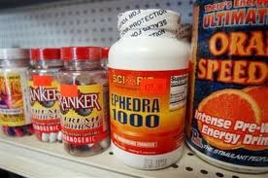
WIAA BANNED SUBSTANCES Please do not used the discouraged substances!
Anabolic Steroids
Anabolic Agent
Stimulants
Peptide Hormones
Dieuretics
Street Drugs (Heroin;Marijuana, etc.
Ephedra, Ephedrine (OTC meds).
BANNED substances:
DISCOURAGED substances:
Creatine
Caffeine-enhanced products
Energy Drinks e.g. Red Bull, Amp, etc.
Herbal caffeine
Ginseng
NoDoz.

Slide 15
Prairie website
https://www.prairieschool.com/
Athletics Page:
Athletic Calendar
Alerts and Announcements for any cancellations or event changes.
Parent Information Tab
Review Handbook
Download Forms
College Links
Team Pages
Spiritwear, etc!

Slide 16
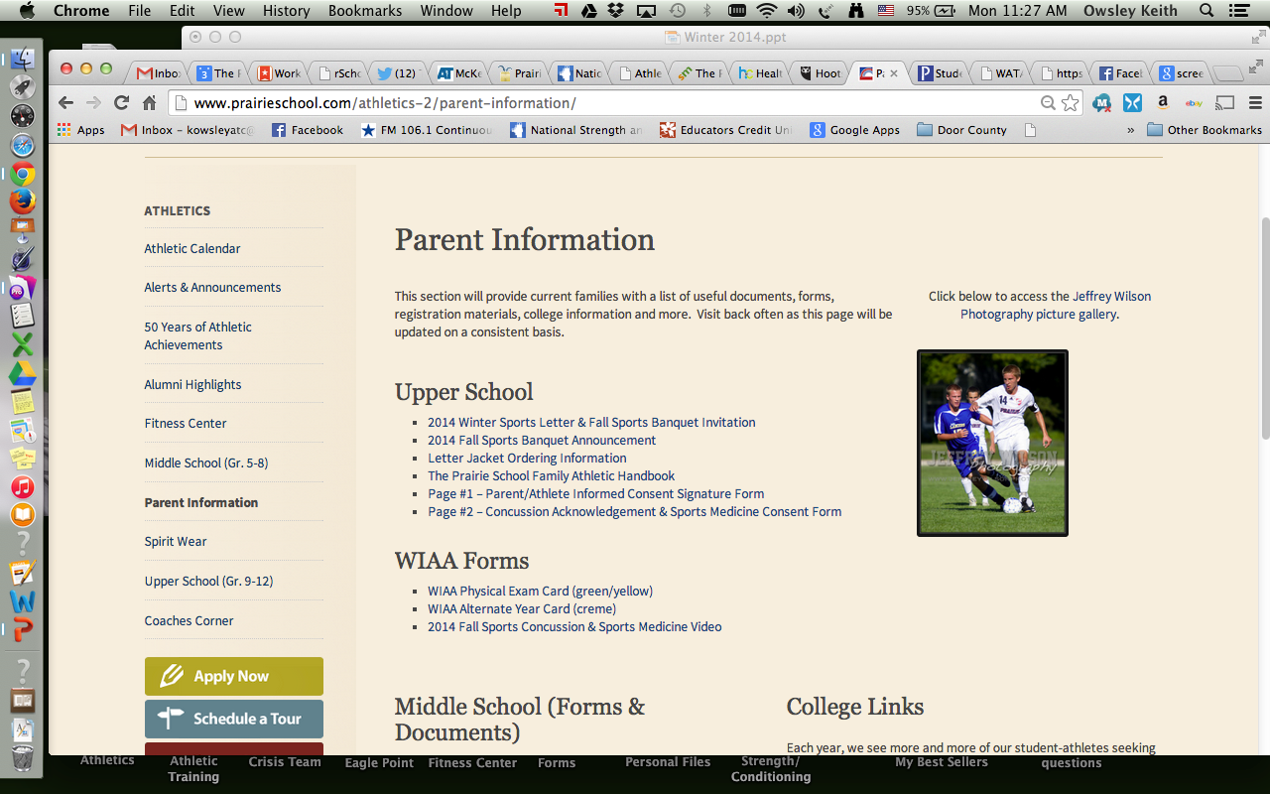
Parents are required to sign this form located on Parent Information tab of the Athletic page.

Slide 17
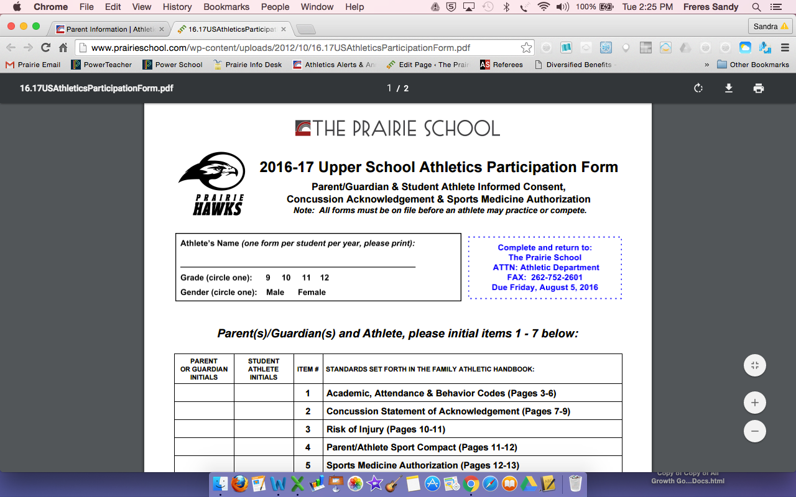
Parent Informed Consent Form

Slide 18
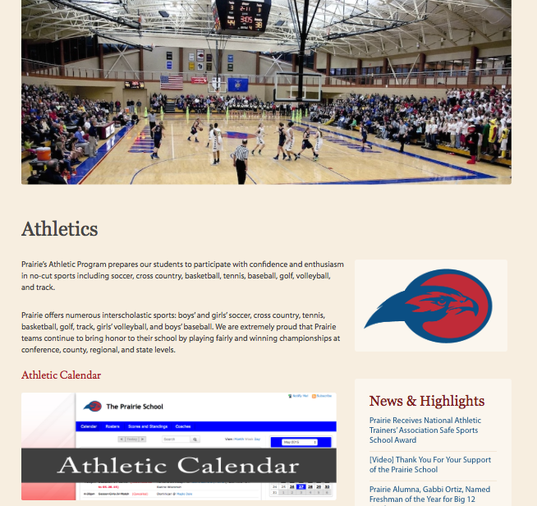
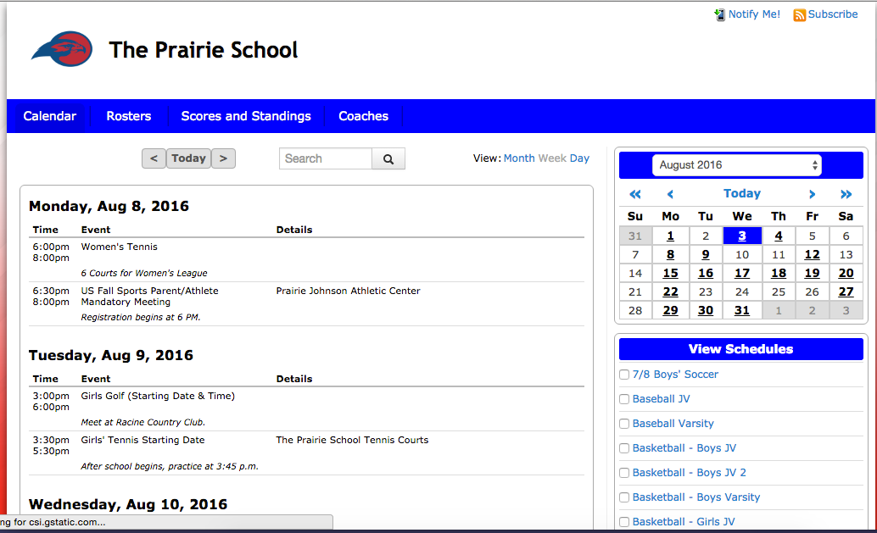
Athletic Calendar Sign up under notify me for changes. View daily and weekly listings.
See View Schedules to view entire team schedule.

Slide 19
Educational-Based Athletics
Recent article: Personal Journal of the Wall Street Journal!
Sports teach us important lessons of emotional management, such as confidence, perseverance, resilience and how to conquer fear and anxiety. Many times these lessons have a permanent impact on our mind-set and attitude well beyond the field.
Sports psychologists believe sports are a microcosm of the larger world with goals, competition, a game plan, results, and feedback.

Slide 20
A Rower
Amy Starin, 53 took up rowing after she developed breast cancer. She now rows competitively for the Chicago Rowing Foundation. She says, “ Every seat has a job that no one else in the boat can fill. She understands her role on the team. “ The assumption is that if the boat is not doing well there has to be something that I can do better in my seat to contribute to the outcome.”

Slide 21
Academics
The Prairie School expects a student-athlete to honor one’s academic commitment first superseding any practice or game. A student-athlete needs to discipline him or herself to manage homework and tests.
Coaches, however, expect student-athletes to budget their time and make every effort to be at practice and a game on time.
Athletes must report to Dention or After School Study Hall even if it involves missing a game or practice.

Slide 22
Behavior Code
A Prairie student athlete should, at all times, be courteous to members of opposing teams and demonstrate respect for self, team, officials, school and community. Any athlete who does not demonstrate this type of positive behavior may be suspended or dismissed from the squad.
A student suspended from school is also suspended from athletic practices and competitions (see All School Information – Discipline.
A student is required to follow the Athletic Code of Conduct on a year-round (12 month) basis. - In-season violations of the school code will result in immediate suspension of the student from interscholastic competition for no less than one day of competition (but not less than one complete game or meet) for acts involving - (a) possession and/or use of alcohol, - (b) possession and/or use of tobacco, including chewing tobacco and/or - (c) Use, possession, buying or selling of controlled substances, street drugs and performance enhancing substances (PES).

Slide 23
Attendance
The Prairie School expects a student athlete to be in school for the entire day of a game or practice in order to compete or practice.
An athlete is also expected to be in school the day after an event. Should there be reason for an athlete to miss school, the Dean of Students, the Athletic Director and/or the coach, must grant permission in order to participate in athletic activities.
Each athlete has a responsibility to be in school and in class on time and to behave while there.
A Prairie School student-athlete is required to respect the integrity of the athletic program. Athletes must understand that their commitment to the school team has a significant impact on other members of his or her team.
The Prairie School coach expects a student-athlete to attend all practices and games.

Slide 24
Transportation
The school provides transportation to all athletic events outside of the city limits. Students must travel by school-contracted vehicles to and from all away events. Although athletes are encouraged to return to Racine with their team, students may return from contests with their parents/guardians if the Transportation Policy is initialed on the Parent/Athlete Informed Consent Signature Form.
When a parent/guardian provides transportation to their son/daughter to or from a scheduled event, the parent/guardian shall assume all resulting liability, and The Prairie School, its Board of Trustees, Officers and Agents shall assume no liability; • When I transport my son/daughter to or from a schedule event;
When I have given my son/daughter permission to transport themselves due to the location of the event and our home.
A parent may not transport another student athlete that is not their child to or from an event.

Slide 25
Sportsmanship
All students and parents must comply with the sportsmanship rules of the Metro Classic and WIAA.
By signing and initializing Sports Compact with the school:
I indicate that I have knowledge, understanding and agreement to these standards set forth in The Family Athletic Handbook in order for my son/daughter to be afforded the privilege of representing The Prairie School as a student athlete. I am also aware that any violation on the part of my child or myself, to any of these standards shall result in the consequences contained within this school policy.

Slide 26
National Federation of H.S.
Good Sportsmanship is viewed by the NFHS and the WIAA and The Prairie School as a commitment to fair play, ethical behavior and integrity. In perception and practice, sportsmanship is defined as those qualities that are characterized by generosity and genuine concern for others. Individuals, regardless of their role in activities, are expected to be aware of their influence on the behavior of others and model good sportsmanship.

Slide 27
How to support your
Son/Daughter during season!
The only six words parents need to say to their kids about sports, or any performance:
Before the Competition:
Have fun.
Play hard.
I love you.
After the competition:
Did you have fun?
I’m proud of you.
I love you.

Slide 28
Fans in the Stands
When unchecked, jeers or unsporting behaviors embarrass individuals or schools, or may initiate a counter response, which may escalate to more disrespectful and offensive responses in return.

Slide 29
Supporting our Athletes and Teams: Please watch both videos!
Golf Commercial
Fan in the Stands

Slide 30
Social Media
We all need to be aware of the misunderstandings and conflicts that social media can ignite within our community. Responding to an opponent’s posting or posting an inappropriate picture or making a comment that is hurtful, harms our entire community.
Coaches or players will post information!
Let’s not have this important tool become a distraction or allow it to interfere with our hard work and efforts!

Slide 31
Communicating with Coaches
Parents are asked to send emails to Coaches only to ask for information, but may not ask about playing time or how to coach. Please wait 24 hours and request a meeting with Coach and athlete.
Practices are closed to spectators. Parents are reminded that they may not stand on the track or in the gym or on the field of play to watch a practice.

Slide 32
Coach Shaun Liesch
Dori Panthofer
Coach Liesch works with our athletes and coaches in developing warm ups and training programs. He aides
Kayla with recovery training and oversees our Fitness Center while serving as my Assistant.
Mrs. Dori Panthofer over sees the paper trail of athletics while producing almost all of our communications and promotions from the Senior Night Celebrations to the offering in the Fitness Center. As my Administrative Assistant, she coordinates the communication of the players, coaches, families, and school.

Slide 33
Coaches and Athletes,
Good Luck This Winter!

